Slide 1
Cloud Computing
Task 3 Spring 2020

Slide 2
Migrate to cloud
Steps
Install AWS CLI tools
Confiture your account for AWS CLI
Import your VM
For undergraduate student, use the provided VM image.
For graduate student, you need to install the VM with Ubuntu 16.04 and use the exported image.
Run your imported VM on EC2

Slide 3
Step 0
For undergraduate student
Download “onepiece.ova” from blackboard
For graduate student
Install virtual box on your computer.
Install Ubuntu 16.04 (you must use this version) as a virtual machine.
Launch your virtual machine and download “submit.bash” from blackboard.
You can use “wget” command or simply copy it from your host machine.
Execute “submit.bash” from you’re your virtual machine.
Copy the output file (phase1.txt) for submission later.
Export the virtual machine to the supported format.
Open Virtualization Archive (OVA), Virtual Machine Disk (VMDK), Virtual Hard Disk (VHD/VHDX), and raw
E.g. onepiece.ova

Slide 4
Step 1
Install AWS CLI on your host machine
Note: Not on your virtual machine
https://docs.aws.amazon.com/cli/latest/userguide/install-cliv1.html

Slide 5
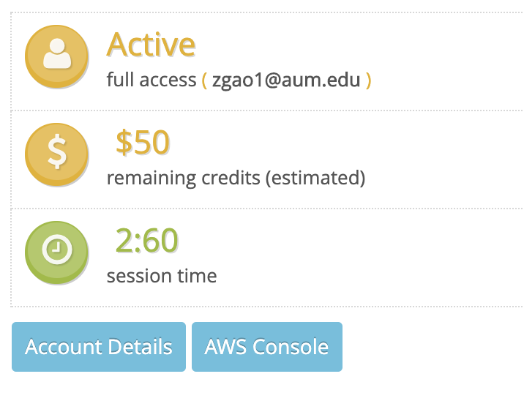

Step 2
Configure your AWS account for CLI tool
Go to your AWS class room
Click “Account Details”

Slide 6
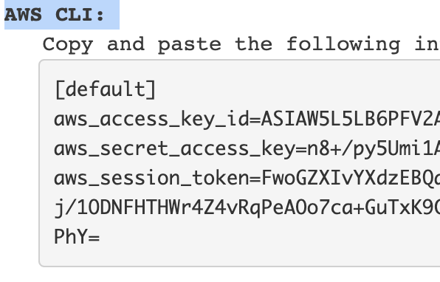
Step 2
Under AWS CLI, click “Show”
For Linux and Mac
Copy and paste the content on the right side into ~/.aws/credentials
For Windows
Copy and paste the content on the right side into "%UserProfile%\.aws\credentials"

Slide 7
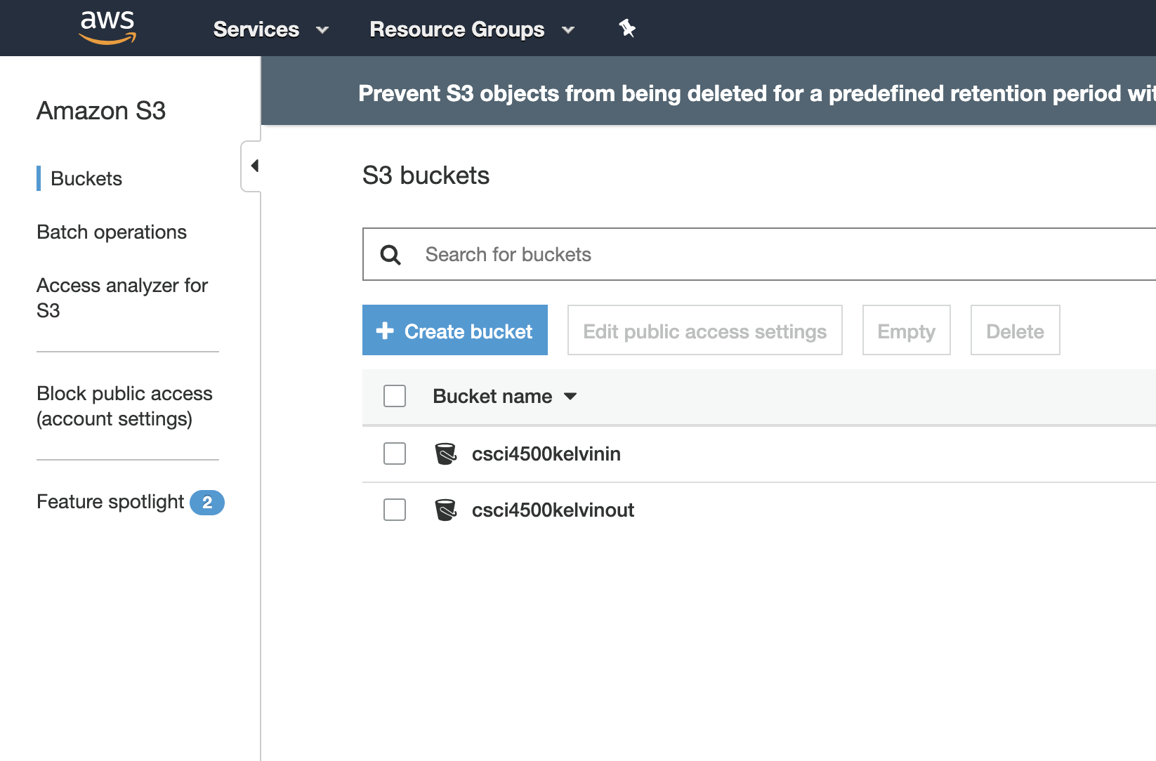
Step 3
Upload the VM to AWS S3
For undergraduate student
Create two buckets on S3
One is for “onepiece.ova”
One is for the converted image.
Upload “onepiece.ova” to the first bucket.
For graduate student
Create two buckets on S3
One is for your vm image
One is for the converted image.
Upload your image to the first bucket.

Slide 8
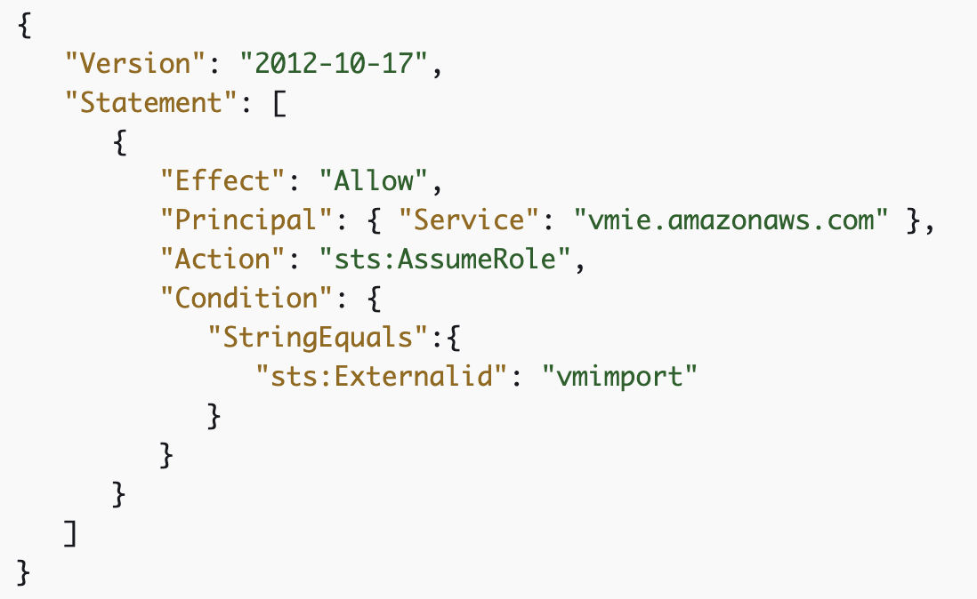
Create Role “vmimport”
https://docs.aws.amazon.com/vm-import/latest/userguide/vmie_prereqs.html#vmimport-role
Follow Step 1,2,3,5 and change the bucket name to yours.

Slide 9
Import the VM
https://docs.aws.amazon.com/vm-import/latest/userguide/vmimport-image-import.html
Follow the instruction “Import the VM”

Slide 10
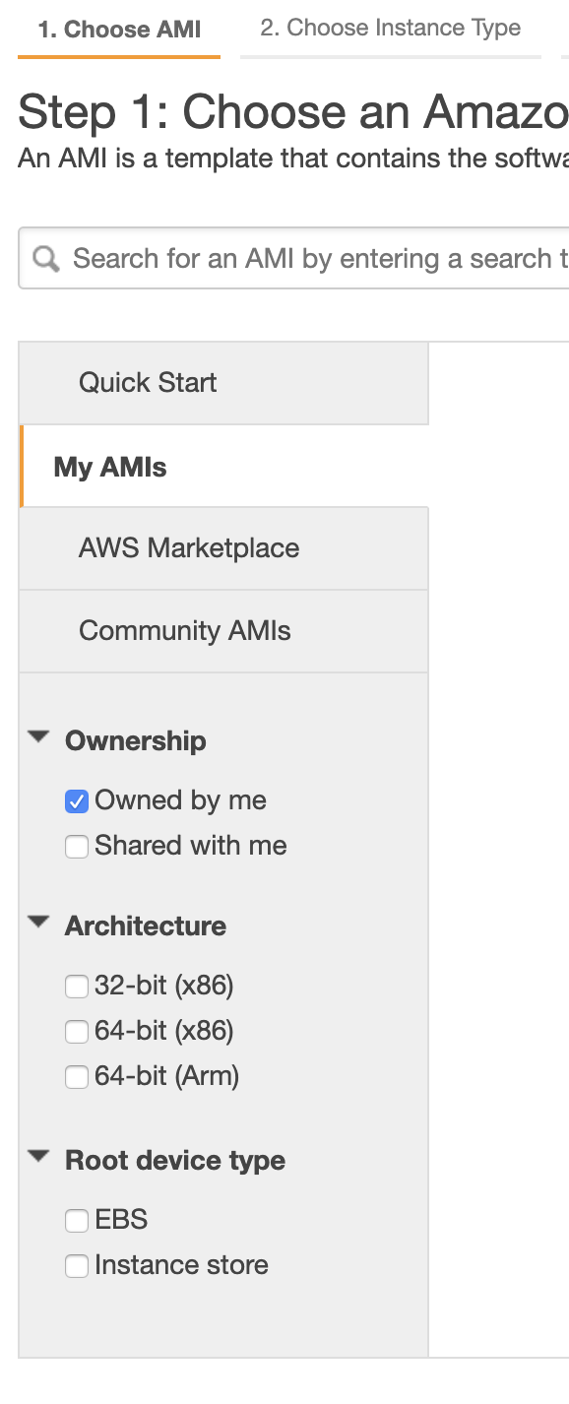
Launch you VM on cloud
Now you should be able to see your VM imported to the cloud from “My AMIs”
Just launch it as normal
The last step, choose “Launch without key”
Then you can use you password and username to log in.
For undergraduate student, the username and password are both “onepiece”

Slide 11
Run submit.sh
Run submit.sh
Both undergraduate and graduate students
Copy phase2.txt to your computer
For graduate students, you need to submit both phase1.txt and phase2.txt
For undergraduate students, you need to submit only phase2.txt

